Slide 1
CPSC 481 Artificial Intelligence
Mr. Ayush Bhardwaj
abhardwaj@fullerton.edu

Slide 2
What we will cover today
Uniform cost search
Informed search
Heuristics
Best-first search
A* algorithm and properties
Generating heuristics

Slide 3
UNIForm cost Search

Slide 4
Cost-Sensitive Search
A
Initial
B
C
E
Goal
D
BFS finds the shortest path in terms of number of actions
It does not consider the length/cost of an action
Cost: total cost of all actions on the path
Can modify BFS to find the least-cost path: uniform cost search

Slide 5

Uniform Cost Search

Slide 6
Uniform Cost Search
Activity: List nodes in increasing path cost
Path Cost: length of shortest path from START node
a
GOAL
2
2
b
c
3
2
1
8
2
e
d
f
3
START
9
8
2
h
1
4
2
p
4
r
q
15
Notes:
Activity: List nodes in increasing cost

Slide 7
Uniform Cost Search
Strategy: expand the “cheapest” node first
Frontier is a priority queue
priority = cumulative cost
a
GOAL
2
2
b
c
3
2
1
8
2
e
d
f
3
START
9
8
2
h
1
4
2
p
4
r
q
15

Slide 8
Uniform cost search
Input: A problem
Data structures:
Frontier (also called “open”)
Priority Queue, ordered by path cost
Explored (also called “closed”)
Set, for efficiency
Initialize frontier with initial state
Initialize explored to empty
Loop do
IF the frontier is empty RETURN FAILURE
Choose lowest cost node from frontier and remove it
IF lowest cost node is goal RETURN SUCCESS
Add node to explored
FOR every child node of node
IF child not already on frontier or explored
insert child node to frontier
ELSE IF child is in frontier with higher path cost
replace existing frontier node with child node

Slide 9
Uniform Cost Search
Priority Queue | Explored
Strategy: expand the “cheapest” node first
Frontier is a priority queue
priority = cumulative cost
a
GOAL
2
2
b
c
3
2
1
8
2
e
d
f
3
START
9
8
2
h
1
4
2
p
4
r
q
15

Slide 10
When should uniform cost terminate?
Should we stop when we discover a goal node?
No: only stop when we expand a goal node
S
F
99
211
80
B
R
97
101
P

Slide 11
When should uniform cost terminate?
Should we stop when we discover a goal node?
No: only stop when we expand a goal node
S
F
99
211
80
B
R
97
101
B
P
S(0)
R(80)
F(99)
P
(177)

Slide 12
Uniform cost search (UCS)
Same as Dijsktra’s shortest paths algorithm
Dijsktra’s algorithm has no “goal”
Shortest paths to all nodes
Implementations of Dijsktra’s algorithm assume all vertices and edges are known before-hand
In UCS, vertices and edges are discovered during the search
Works for infinite graphs also

Slide 13
Uniform Cost Search (UCS) Properties
What nodes does UCS expand?
Processes all nodes with cost less than cheapest solution!
If that solution costs C* and arcs cost at least ε , then the “effective depth” is roughly C*/ε
Takes time O(b^{C*/ε})
exponential in effective depth
How much space does the frontier take?
Has roughly the last tier, so O(b^{C*/ε})
Is it complete?
Assuming best solution has a finite cost and minimum edge cost is positive, yes!
Is it optimal?
Yes!
b
c ≤ 1
…
C*/ε “tiers”
c ≤ 2
c ≤ 3

Slide 14
Uniform Cost Issues
The good: UCS is complete and optimal!
The bad:
Explores options in every “direction”
No information about goal location
Solution: consider distance from goal too
c ≤ 1
…
c ≤ 2
c ≤ 3
Start
Goal

Slide 15
Informed Search

Slide 16




Search Heuristics
A heuristic is:
A function that estimates how close a state is to a goal
Designed for a particular search problem
Examples: Manhattan distance, Euclidean distance
10
5
11.2

Slide 17

Greedy Best-First Search

Slide 18
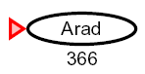

Greedy Best-First Search
Expand the node that seems closest according to heuristic
Heuristic: estimate of distance to nearest goal for each state
Also called “Pure heuristic search”
Notes:
Greedy (Arad > Sibiu > Fagaras > Buch) is longer than Arad > Sibiu > RV > Pitesti > Buch

Slide 19

Video of Demo Contours Greedy (Empty)

Slide 20
Video of Demo Contours Greedy (Pacman Small Maze)

Slide 21
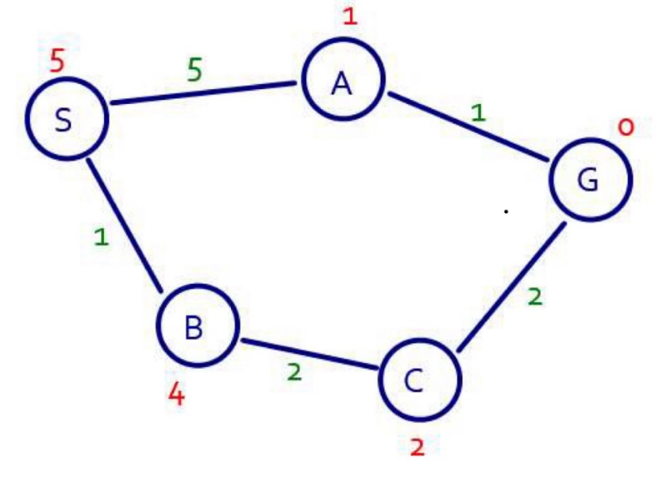
Greedy Best-first search
What can go wrong?
Not optimal
Can get stuck in dead ends
Not complete
Heuristic cost (perfectly accurate!)
Actual cost
D
E
C
F
S
G
H
B
Notes:
Greedy (Arad > Sibiu > Fagaras > Buch) is longer than Arad > Sibiu > RV > Pitesti > Buch

Slide 22
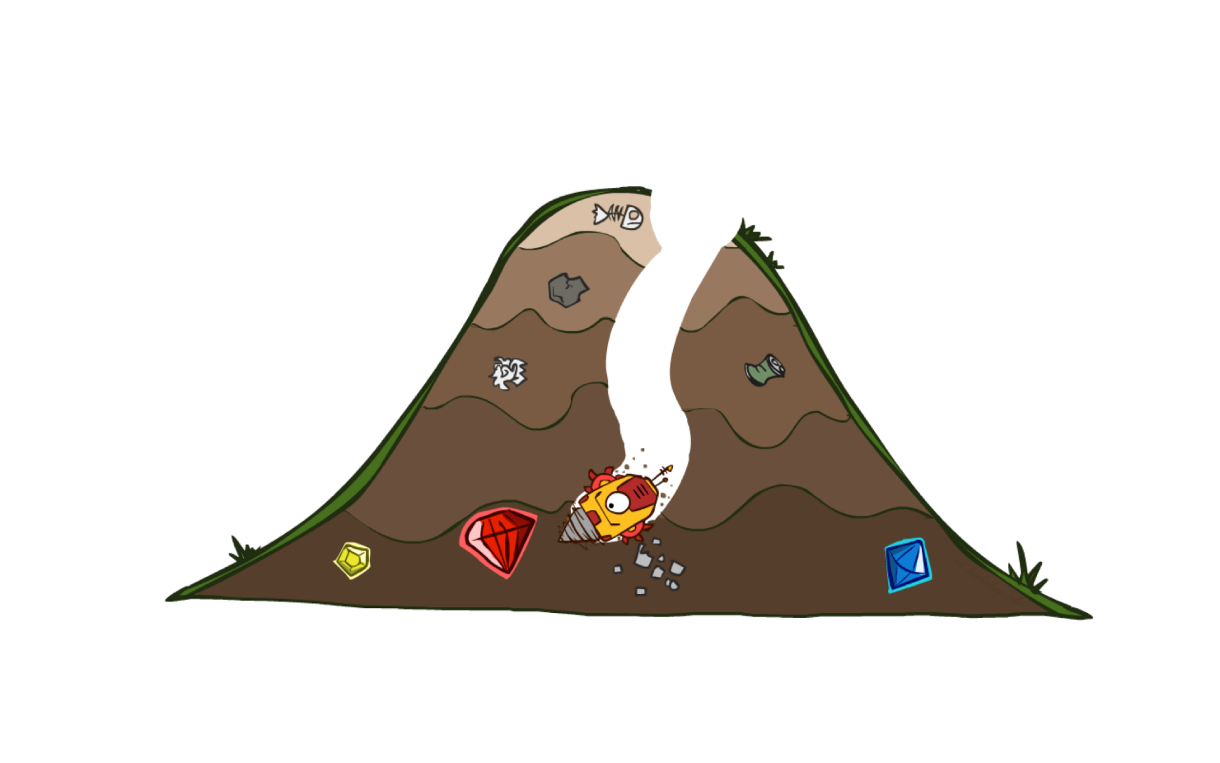
A* Search

Slide 23
Combining UCS and Greedy
Uniform-cost orders by path cost, or backward cost g(n)
Greedy orders by goal proximity, or forward cost h(n)
A* Search orders by the sum: f(n) = g(n) + h(n)
A* is pronounced “A star”
8
S
g = 0 h=6
e
h=1
g = 1 h=5
a
1
S
1
a
3
d
2
G
g = 2 h=6
g = 4 h=2
g = 9 h=1
b
d
e
h=6
1
h=5
h=2
h=0
c
1
b
g = 3 h=7
g = 6 h=0
g = 10 h=2
c
G
d
h=7
h=6
G
g = 12 h=0
Example: Teg Grenager

Slide 24
A* search
Input: A problem
Data structures:
Frontier (also called “open”)
Priority Queue, ordered by path cost + heuristic cost
Explored (also called “closed”)
Set, for efficiency
Initialize frontier with initial state
Initialize explored to empty
Loop do
IF the frontier is empty RETURN FAILURE
Choose lowest cost node from frontier and remove it
IF lowest cost node is goal RETURN SUCCESS
Add node to explored
FOR every child node of node
IF child not already on frontier or explored
insert child node to frontier
ELSE IF child is in frontier with higher path cost
replace existing frontier node with child node

Slide 25
Example: A* for shortest path with straight-line heuristic
h(n): Straight-line distance from n to Bucharest
h( Arad )= 350
h( Bucharest )= 0
h( Craiova )= 152
h( Drobeta )= 236
h( Eforie )= 165
h( Fagaras )= 154
h( Giurgiu )= 62
h( Hirsova )= 135
h( Iasi )= 193
h( Lugoj )= 240
h( Mehadia )= 232
h( Neamt )= 210
h( Oradea )= 363
h( Pitesti )= 89
h( Rimnicu )= 186
h( Sibiu )= 232
h( Timisoara )= 317
h( Urziceni )= 60
h( Vaslui )= 159
h( Zerind )= 356

Slide 26
Example: Heuristic Function
h(n)

Slide 27
Frontier (priority queue) | Explored (set)
A(0+366=366) | {}
Z(75+374=449), S(140+253=393), T(118+329=447) | {A}
Z(449), T(447) | {A,S}

Slide 28
Class work
Work out by hand the steps in A*
To go from Arad to Bucharest
Use the Euclidean distance as the heuristic
Graph and heuristics on previous slides

Slide 29
Properties of A*
A* SEARCH

Slide 30
Is A* Optimal?
h = 6
1
A
3
S
h = 7
G
h = 0
5
What went wrong?
Estimated goal cost > actual goal cost
We need estimates to be less than actual costs!

Slide 31
Conditions for optimality of A*
Heuristic must be admissible
Must never overestimate true cost
Admissible (optimistic) heuristics slow down bad plans but never outweigh true costs

Slide 32
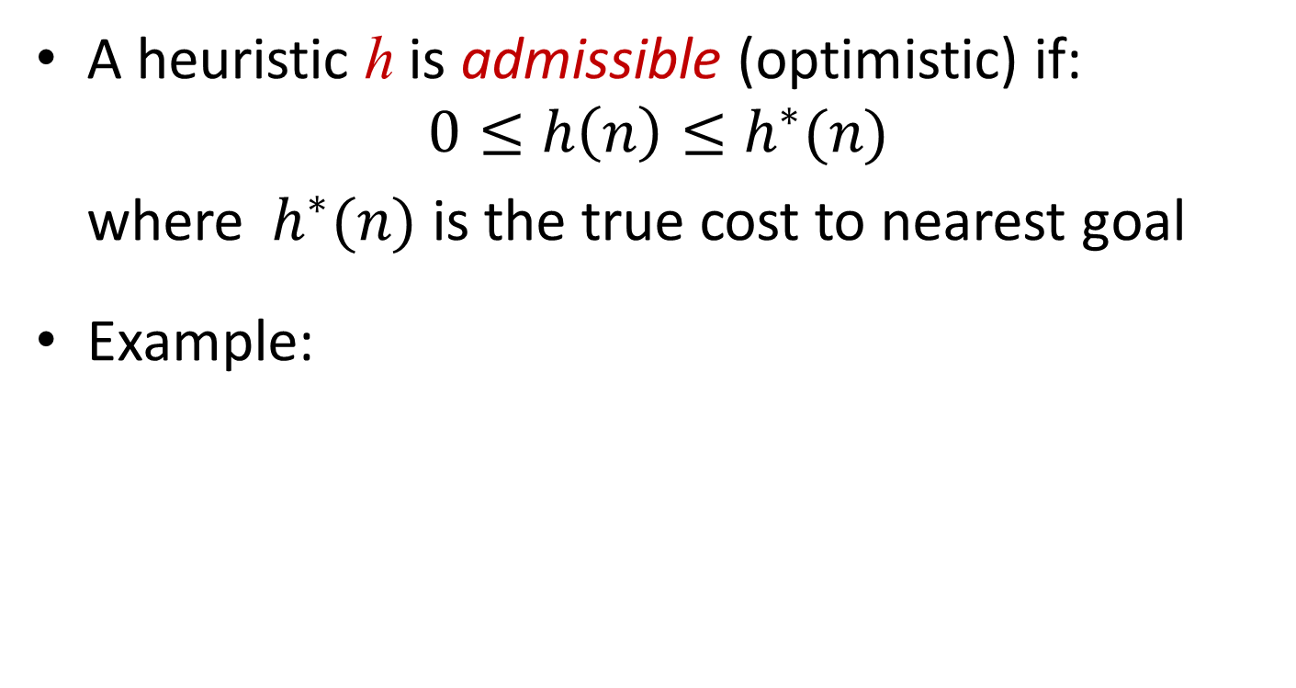
Admissible Heuristics
A heuristic h is admissible (optimistic) if:
$$0≤h\left(n\right)≤h^{∗}(n)$$
where $h^{∗}(n)$ is the true cost to nearest goal
Example:
15

Slide 33
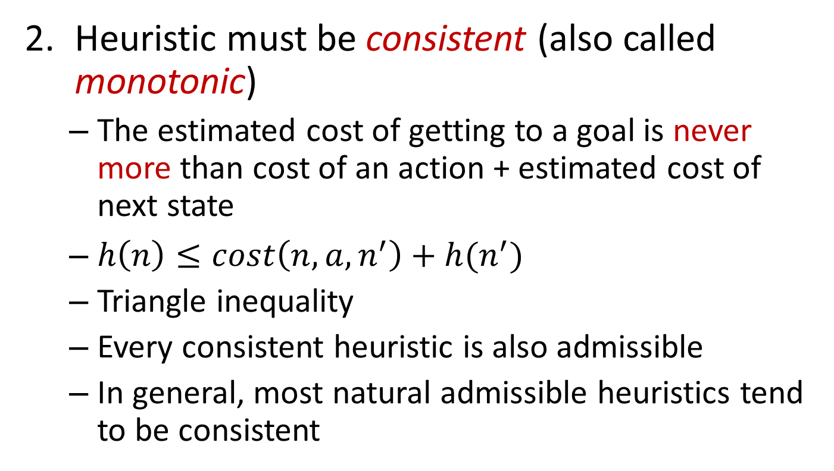
Conditions for optimality of A*
Heuristic must be consistent (also called monotonic)
The estimated cost of getting to a goal is never more than cost of an action + estimated cost of next state
$h\left(n\right)≤cost\left(n,a,n^{′}\right)+h(n^{′})$
Triangle inequality
Every consistent heuristic is also admissible
In general, most natural admissible heuristics tend to be consistent
G
h(n)
h(n’)
n
n’
cost(n,a,n’)

Slide 34

Optimality of A* Search
Complete
Terminates even on infinite state spaces if a reachable goal exists
Optimal
Always finds the closest goal
Optimally efficient
No other optimal algorithm with the same heuristics expands fewer nodes
Note: Uniform cost search is a special case of A* (h = 0)

Slide 35
Proof of Optimality of A* Graph Search
Sketch: consider what A* does with a consistent heuristic:
Fact 1: In tree search, A* expands nodes in increasing total f value (f-contours)
Fact 2: For every state s, nodes that reach s optimally are expanded before nodes that reach s suboptimally
Result: A* graph search is optimal
…
f ≤ 1
f ≤ 2
f ≤ 3

Slide 36
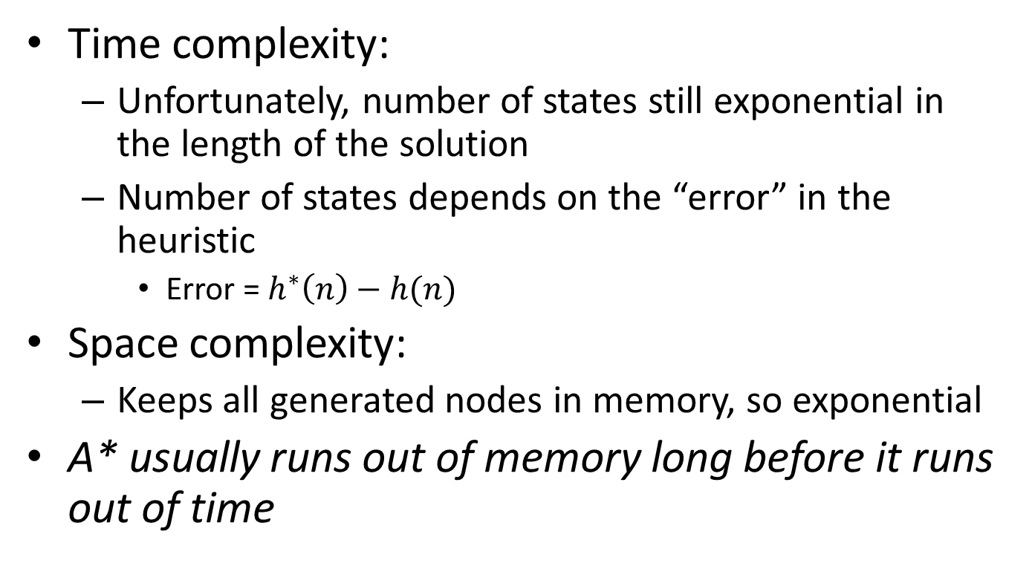
Complexity of A* Search
Time complexity:
Unfortunately, number of states still exponential in the length of the solution
Number of states depends on the “error” in the heuristic
Error = $h^{∗}\left(n\right)−h(n)$
Space complexity:
Keeps all generated nodes in memory, so exponential
A* usually runs out of memory long before it runs out of time

Slide 37
Properties of A*
Uniform-Cost
A*
b
b
…
…

Slide 38
UCS vs A* Contours
Uniform-cost expands equally in all “directions”
A* expands mainly toward the goal, but does hedge its bets to ensure optimality
Start
Goal
Start
Goal

Slide 39
Video of Demo Contours (Empty) -- UCS

Slide 40
Video of Demo Contours (Empty) -- Greedy

Slide 41
Video of Demo Contours (Empty) – A*

Slide 42
Video of Demo Contours (Pacman Small Maze) – A*

Slide 43



Comparison
Greedy
Uniform Cost
A*

Slide 44
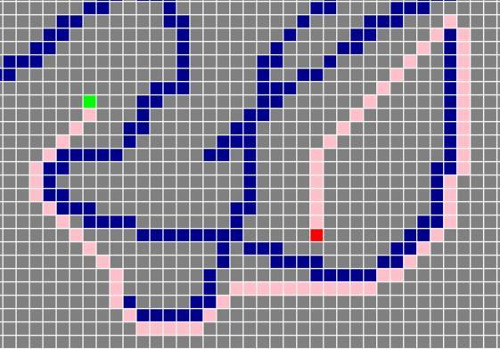
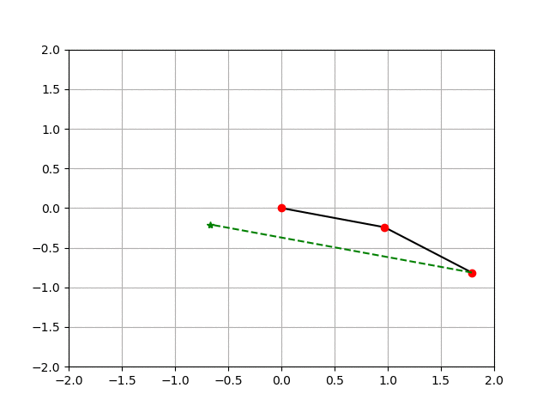
A* Applications
Video games
Path planning
Resource planning problems
Robot motion planning
…

Slide 46
Creating Heuristics
A* SEARCH

Slide 47
Creating Admissible Heuristics
Most of the work in solving hard search problems optimally is in coming up with admissible heuristics
Often, admissible heuristics are solutions to relaxed problems, where new actions are available
Inadmissible heuristics are often useful too
15
Manhattan distance: assume you can break through walls
Euclidean distance: assume you can fly

Slide 48
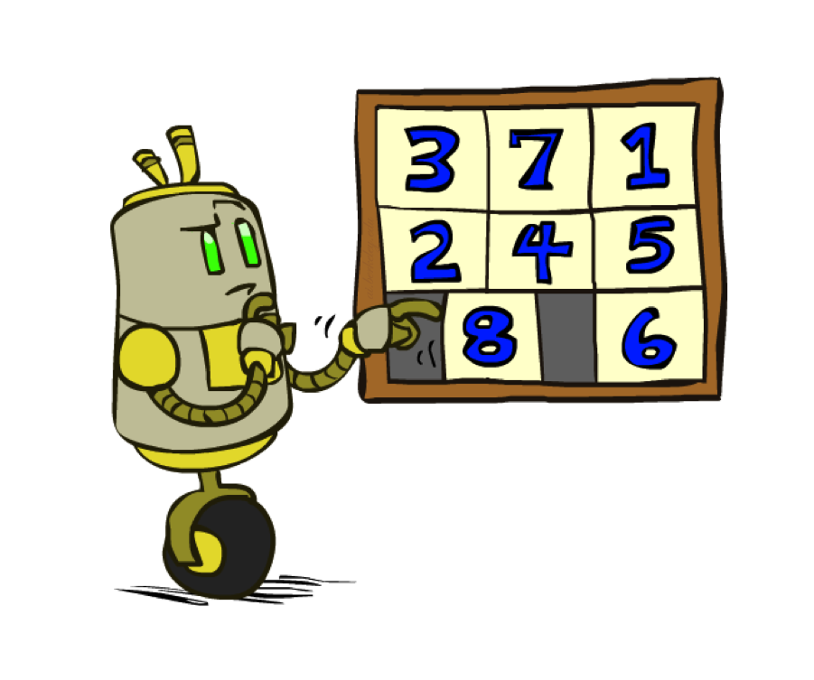
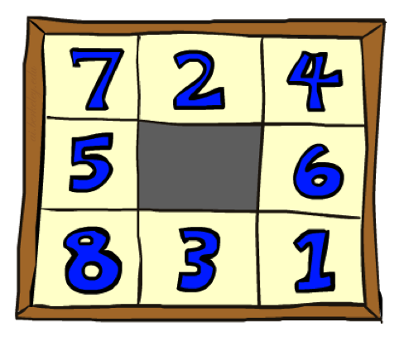
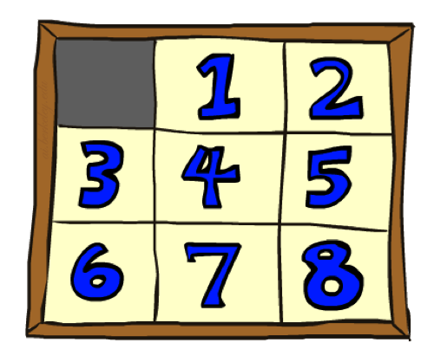
Example: 8 Puzzle
Start State
Actions
Goal State
What are the states?
How many states?
What are the actions?
How many successors from the start state?
What should the costs be?

Slide 49
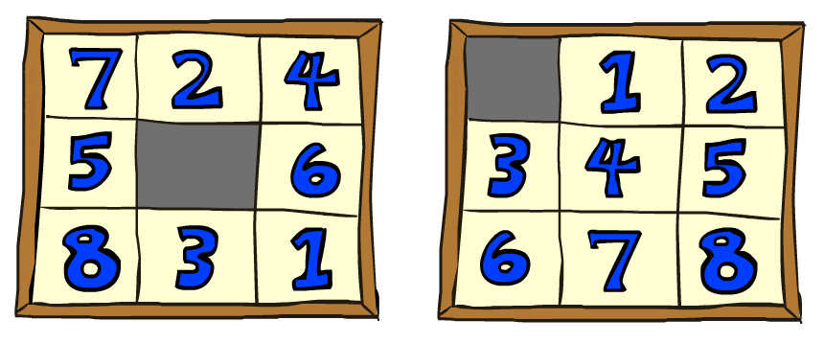
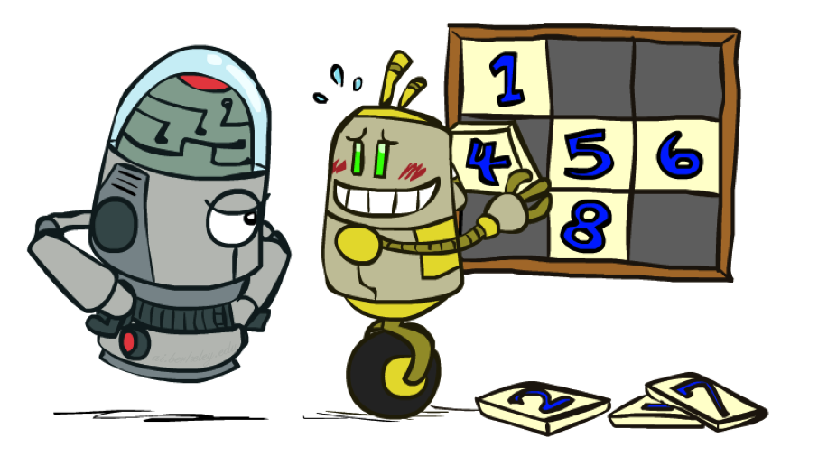
8 Puzzle I
Heuristic: Number of tiles misplaced
h(start) =
This is a relaxed-problem heuristic
Why is it admissible?
8
Start State
Goal State

Slide 50
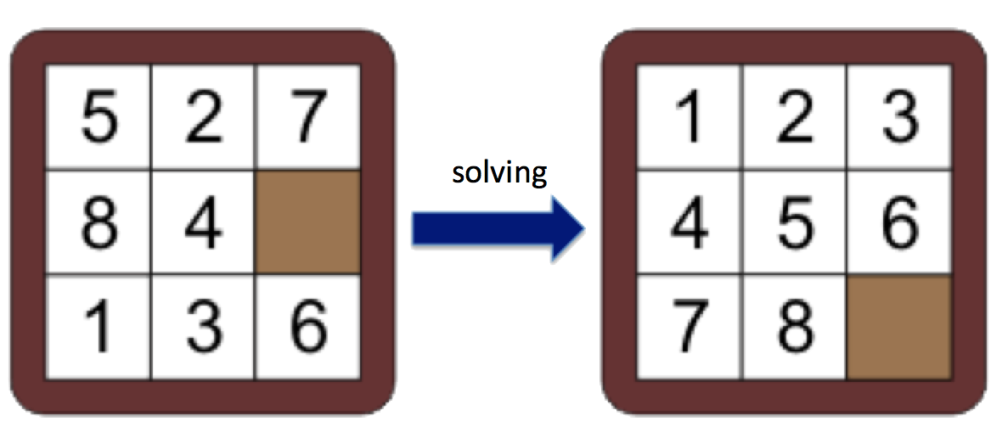
Sliding tile puzzle: misplaced tiles heuristic
h(n) = ?

Slide 51
8 Puzzle I
Heuristic: Number of tiles misplaced
This is a relaxed-problem heuristic
Why is it admissible?
 | Average nodes expanded when the optimal path has…
 | …4 steps | …8 steps | …12 steps
Uninformed search (UCS) | 112 | 6,300 | 3.6 x 10⁶
A* + heuristic=TILES | 13 | 39 | 227
Statistics from Andrew Moore

Slide 52
8 Puzzle II
What if we had an easier (“relaxed”) 8-puzzle where any tile could slide any direction at any time, ignoring other tiles?
h(start) =
Total Manhattan distance
Why is it admissible?
3 + 1 + 2 + … = 18
Start State
Goal State

Slide 53
Sliding tile puzzle: Manhattan distances heuristic
h(n) = ?
= 2+0+4+2+1+2+3+1=15

Slide 54
8 Puzzle II
What if we had an easier (“relaxed”) 8-puzzle where any tile could slide any direction at any time, ignoring other tiles?
Total Manhattan distance
Start State
Goal State
 | Average nodes expanded when the optimal path has…
 | …4 steps | …8 steps | …12 steps
Uninformed search (UCS) | 112 | 6,300 | 3.6 x 10⁶
A* + heuristic=TILES | 13 | 39 | 227
A* + heuristic=MANHATTAN | 12 | 25 | 73

Slide 55
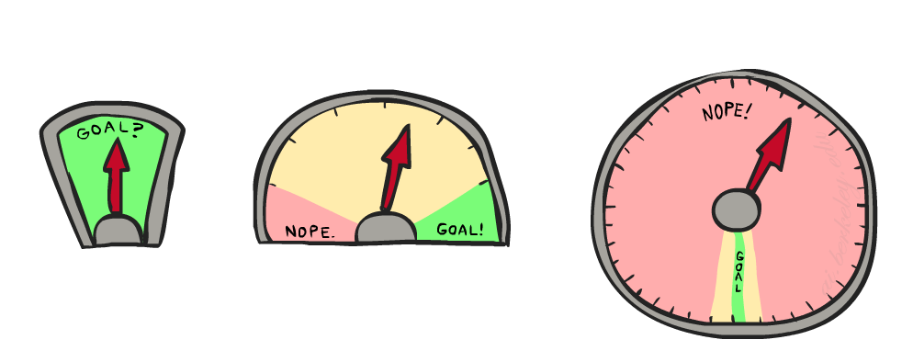
8 Puzzle III
How about using the actual cost as a heuristic?
Would it be admissible?
Would we save on nodes expanded?
What’s wrong with it?
With A*: a trade-off between quality of estimate and work per node
As heuristics get closer to the true cost, you will expand fewer nodes but usually do more work per node to compute the heuristic itself

Slide 56
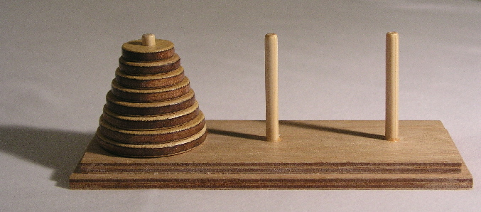

Class work
Consider the puzzle “Towers of Hanoi”
Move disks, one at a time, from Left to Right peg using Spare peg as needed
A disk can only be placed on top of a larger disk
What could be a state representation?
What are the actions?
Let the “length” of a solution be the number of disk moves
Think of some heuristics for this puzzle
Are these admissible?

Slide 57
State representation (3-tuple of sets):
{5,4,3,2,1} {} {}: at least how many moves
{} {} {5,4,3,2,1}: 0
{5, 4}{3}{2,1}: ??
def h(state)
return len(state[0])+len(state[1])

Slide 58

A*: Summary
A* uses both backward costs and (estimates of) forward costs
A* is optimal with admissible / consistent heuristics
Heuristic design is key: often use relaxed problems

Slide 59
References
George Fluger, Artificial Intelligence: Structures and Strategies for Complex Problem Solving, 6th edition, Addison Wesley, 2009. Chapter 3.
Russel and Norvig, Artificial Intelligence: A Modern Approach, 3rd edition, Prentice Hall, 2010. Chapter 3.3

Slide 60
Acknowledgement
https://inst.eecs.berkeley.edu/~cs188/su20/

